Slide 1


Data Visualization through Excel
- Excel dashboards

Slide 2

Session-II Plan
Common terminologies.
Data understanding.
Creation of column chart.
Creation of bar chart.
Creation of heat map.
Simple dashboard.
Assessment
Summary and Interaction.

Slide 3
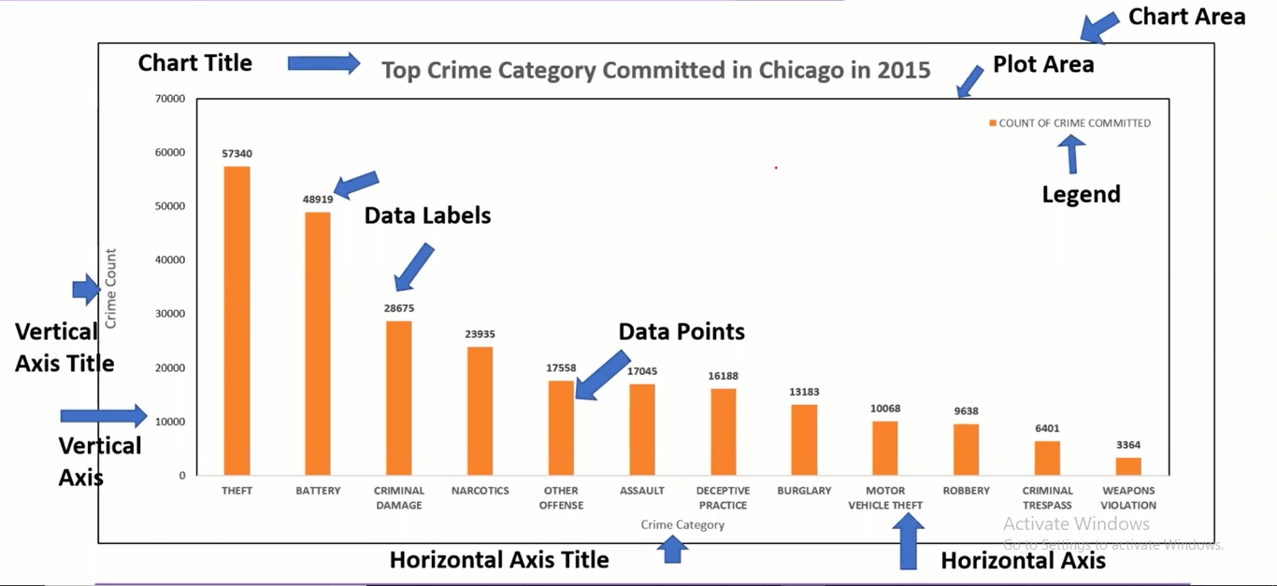
Common components /Terminology of the chart.

Slide 4
What is Excel dashboard ?
An Excel dashboard is one-pager (mostly, but not always necessary) that helps managers and business leaders in tracking key KPIs or metrics and take a decision based on it.
It contains charts/tables/views that are backed by data.
A dashboard is often called a report, however, not all reports are dashboards.

Slide 5
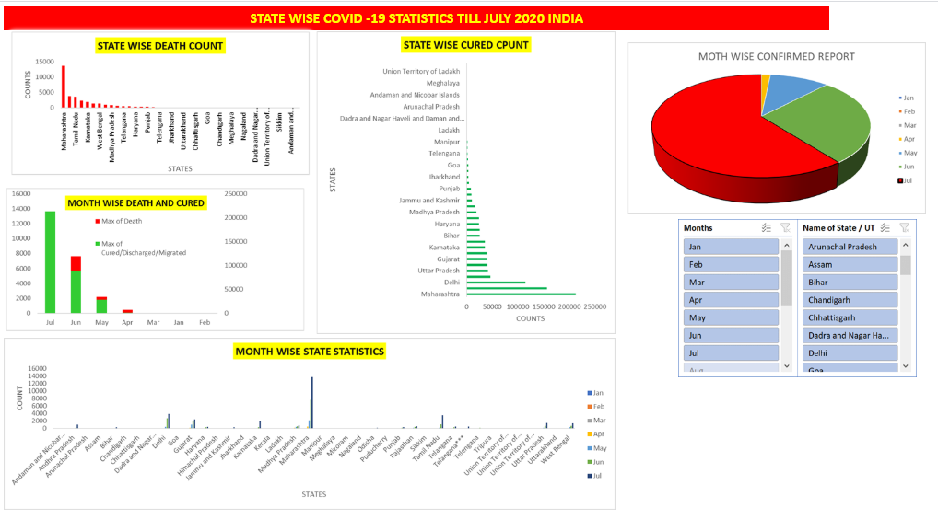
DASHBOARD IN EXCEL

Slide 6
Before you start !
Import your data into Excel
Clean your data
Set up your workbook
Understand your requirements

Slide 7


Slide 8
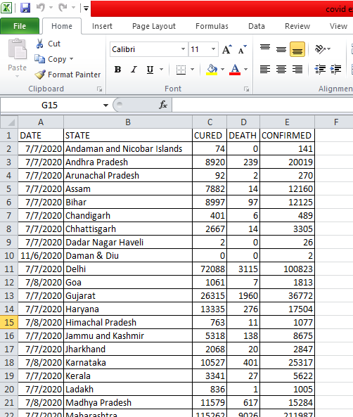
CREATING SIMPLE EXCEL DASHBOARD FOR COVID 19 INDIA DATA

Slide 9
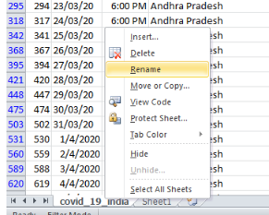
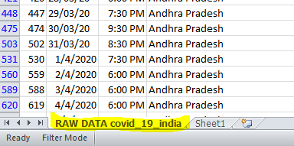
STEPS
1.Read data carefully and understand what it is.
2.Rename the sheet as Raw data as shown

Slide 10
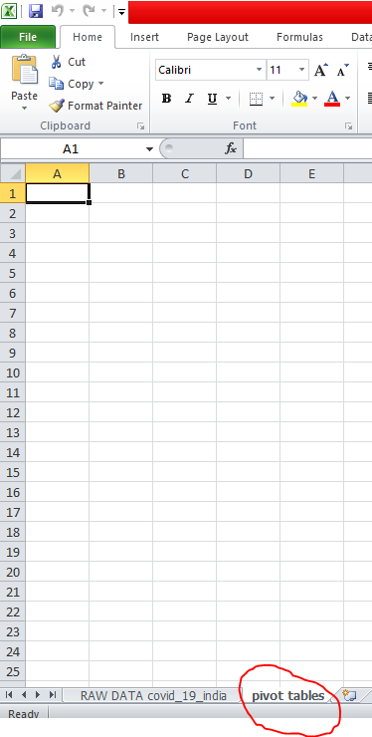
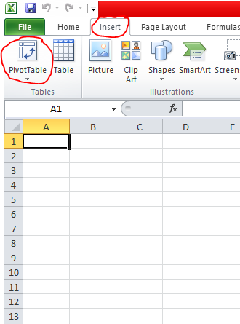
3.Create new sheet and rename it as pivot tables.
4. in pivot table sheet click on insert option and then click on pivot table.

Slide 11
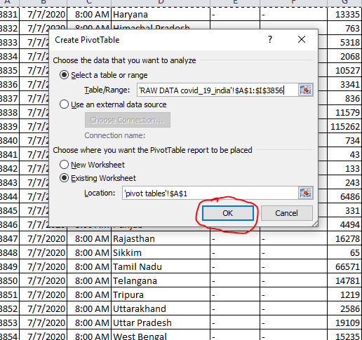
5. Now you got pivot table asking range of the sheet or data for which table to be put. Go to raw data sheet and select the range and click ok.

Slide 12
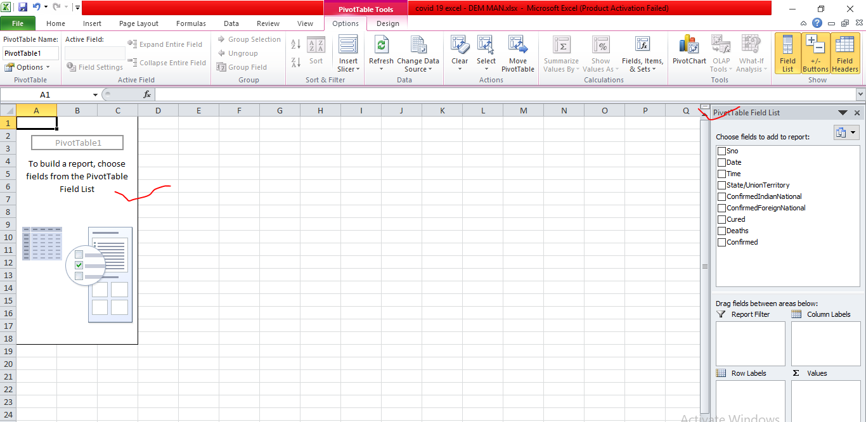
6. Now the pivot table is ready with pivot table field list.

Slide 13
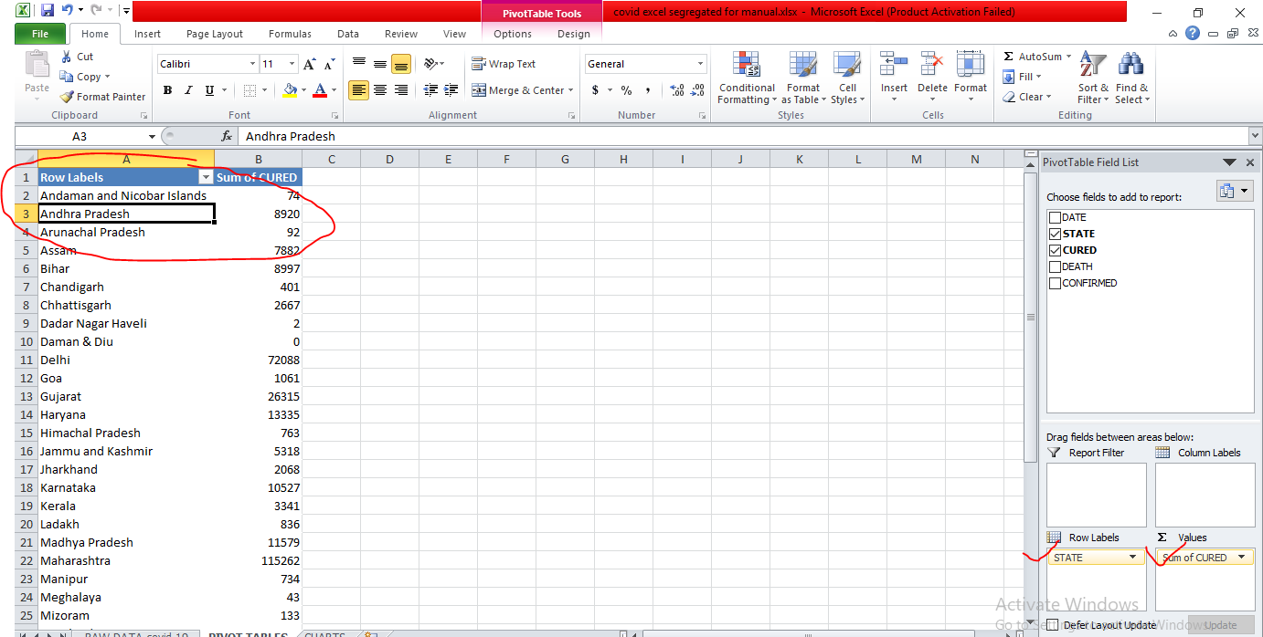
7. Select data variable for which you would like to put chart and drag them to appropriate areas mention at the bottom of PTF list (Drag and drop). Example states in ROW LABEL and count of cured value in VALUES. Now segregated data has been filtered from raw sheet and generated separate table.

Slide 14
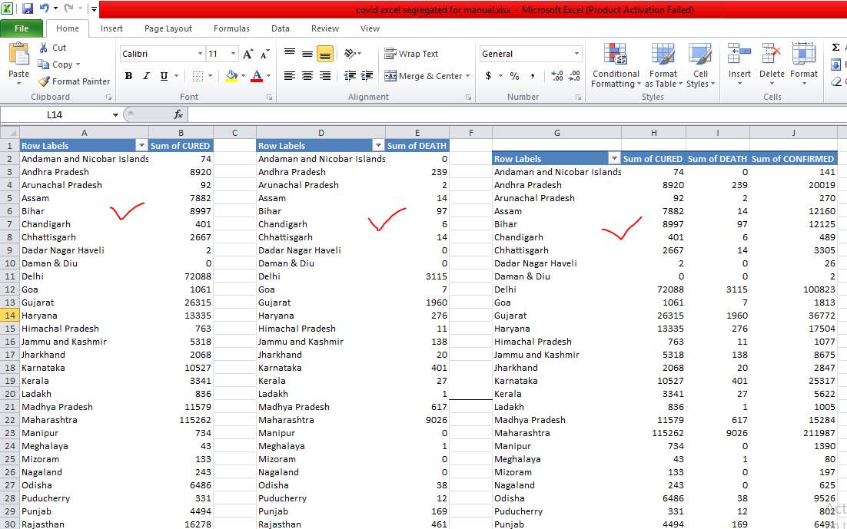
8. Repeat the procedure and create multiple pivot tables as per requirement on same sheet. In this examples three pivot tables are formed a) state wise cured count b) state wise death and c) state wise cured, death, confirmed.

Slide 15
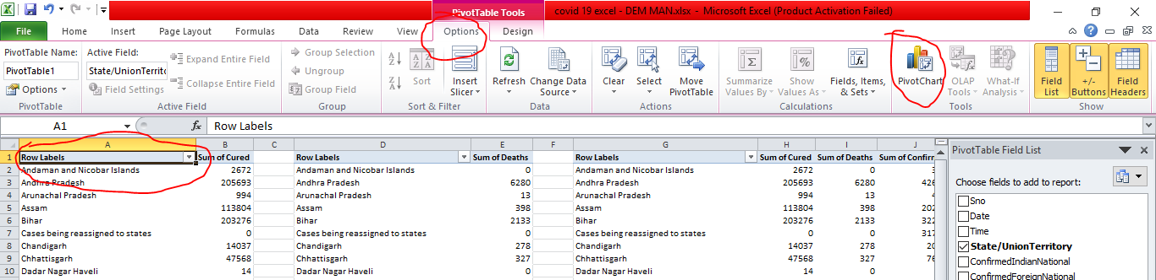
9.Now select particular pivot table data to put chart. Here I clicked on row label of first pivot and clicked on option. There we will get pivot chart option.

Slide 16
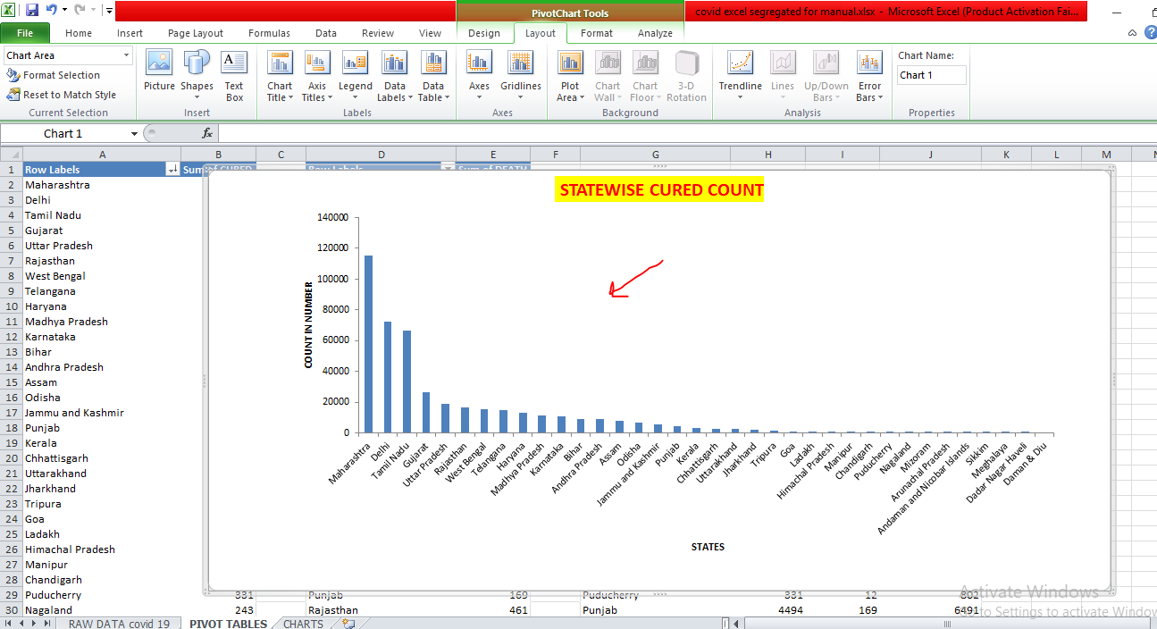
10. Once you click on pivot chart it will ask you to select type of chart. As here we are having two variables to compare the data I will select column chart and click on ok.

Slide 17
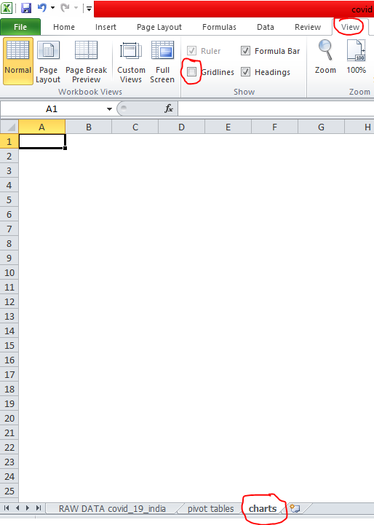
11. Go to new sheet (click on new sheet) and rename as charts. After renaming the sheet go to view and uncheck gridlines to make sheet plain.

Slide 18
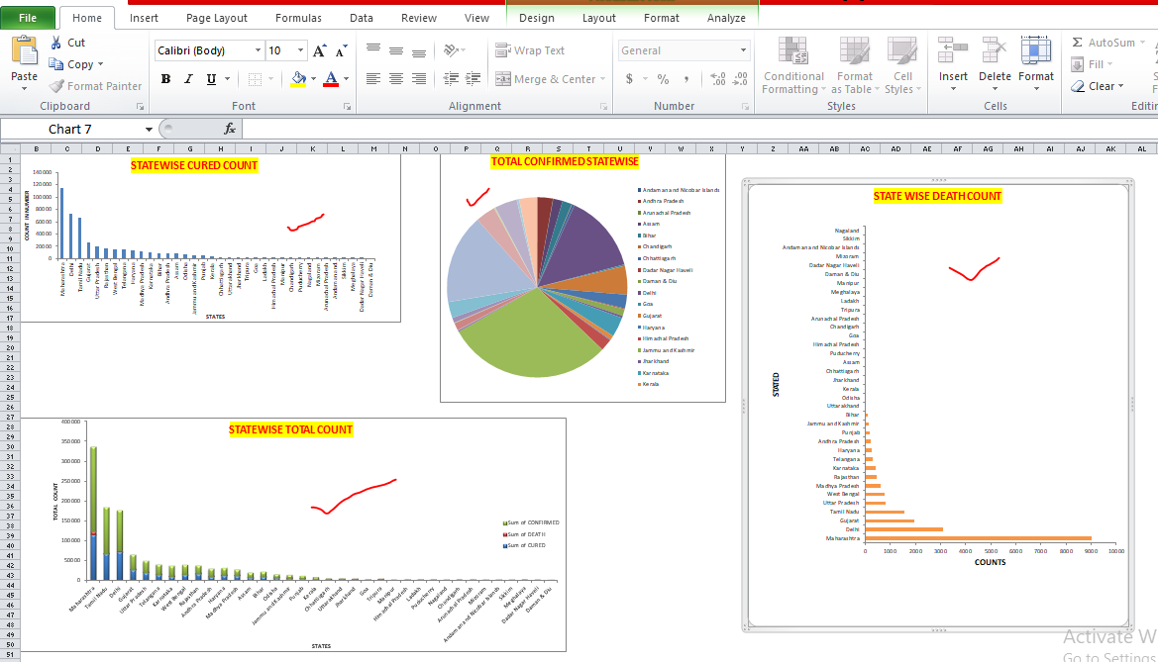
12. Repeat the procedure 9 and 10 to create required different charts, transfer all the charts drawn for pivot table using cut and paste option. Before doing it we should modify chart with effective visualization like color, axis title, chart title, data labeling etc.

Slide 19
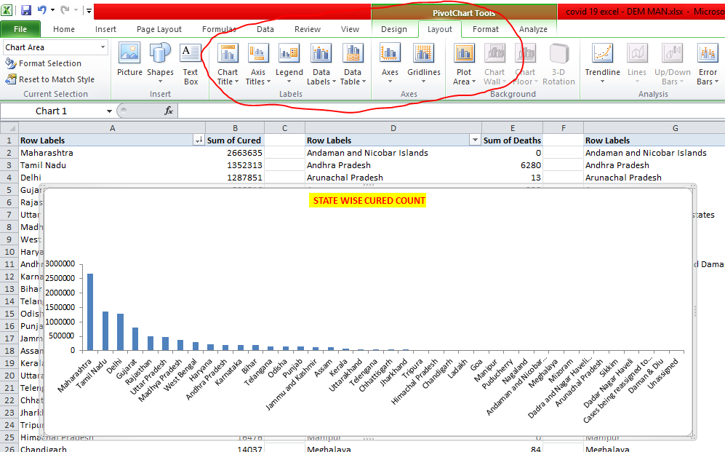
13. These modifications can be done through layout option which will appear after clicking on chart.

Slide 20
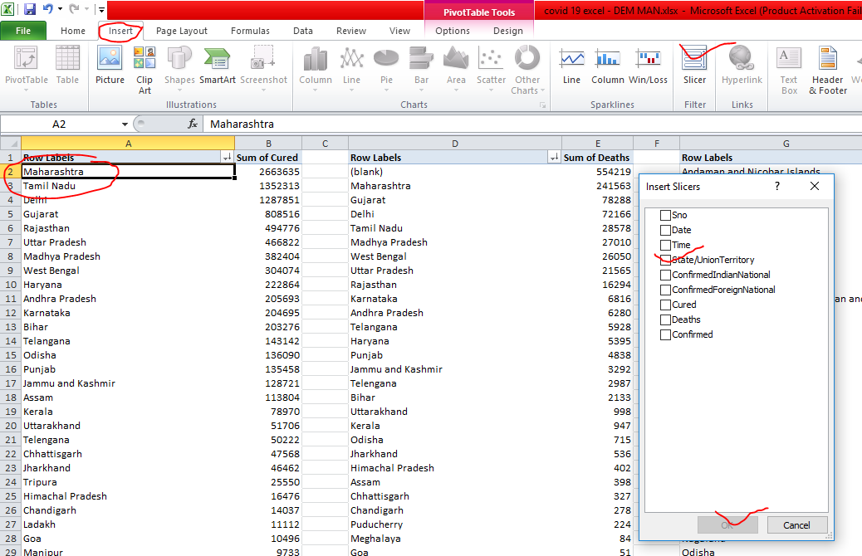
14. Once all charts are transferred to charts sheet after modification connect all pivot tables using slicer option. For that purpose go to pivot tables sheet then select any table > insert > click on slicer. Select state/union territory and click on ok.

Slide 21
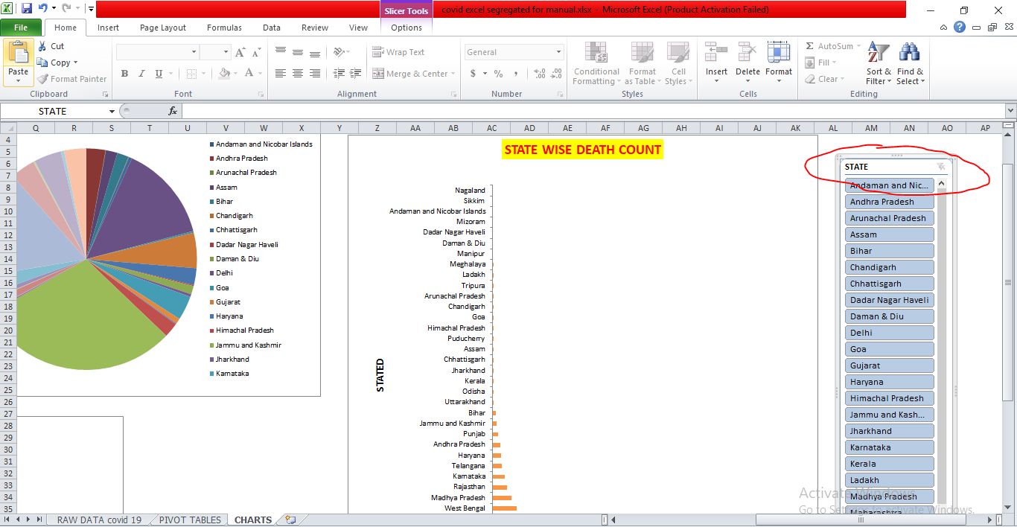
15. Now slicer has been added, cut and pastes that slicer to charts sheet.

Slide 22
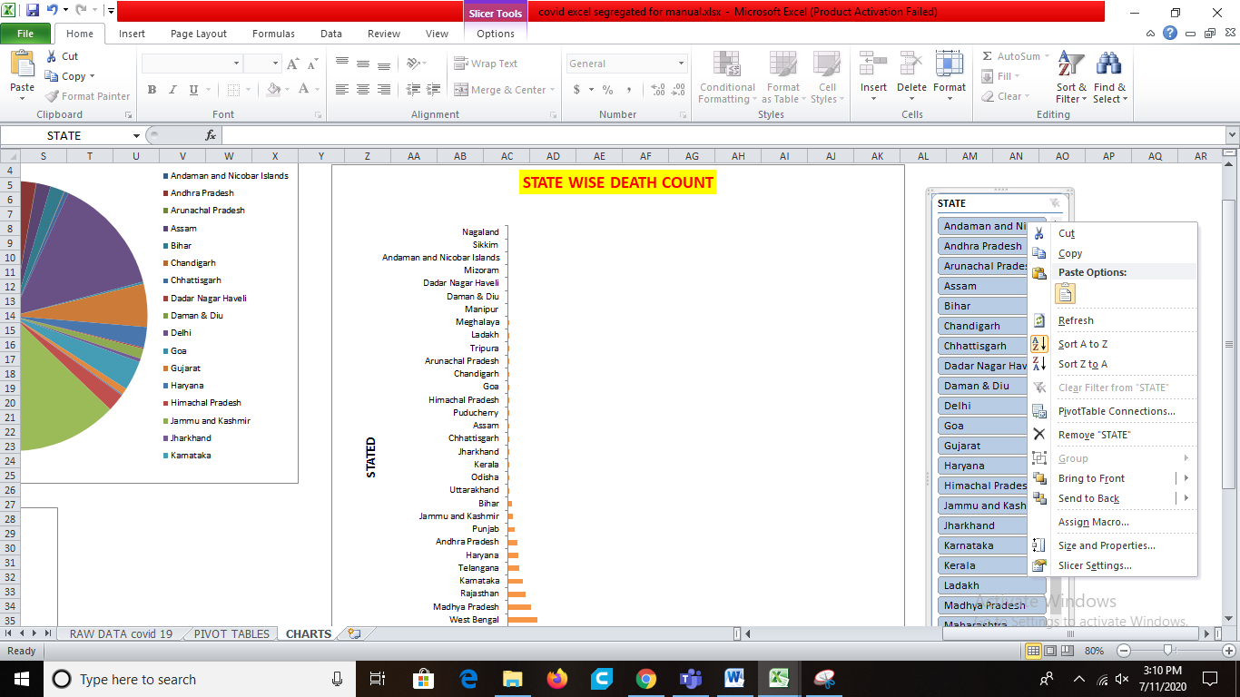
16. This slice is having link with only that particular chart now we need link this slicer to remaining chart by right clicking on that and use connect pivot tables option.

Slide 23
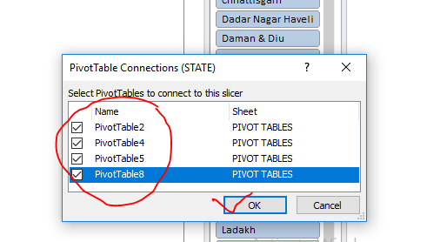
17. After clicking Pivot table connections, we will get a popup asking which all pivot table need to be connected? In this example we have selected all pivot tables and clicked ok as shown in figure.

Slide 24
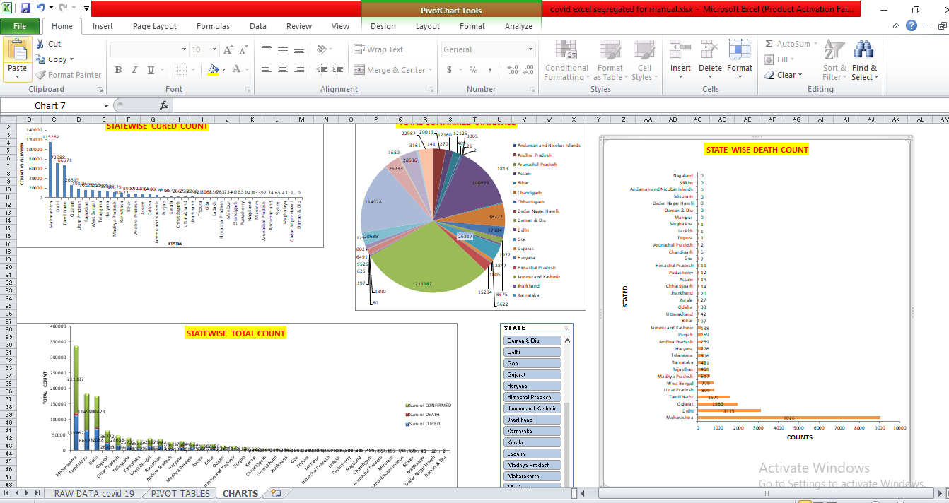
18. Now all pivot tables are connected to that slicer. We can now interact with simple dashboard

